Slide 1

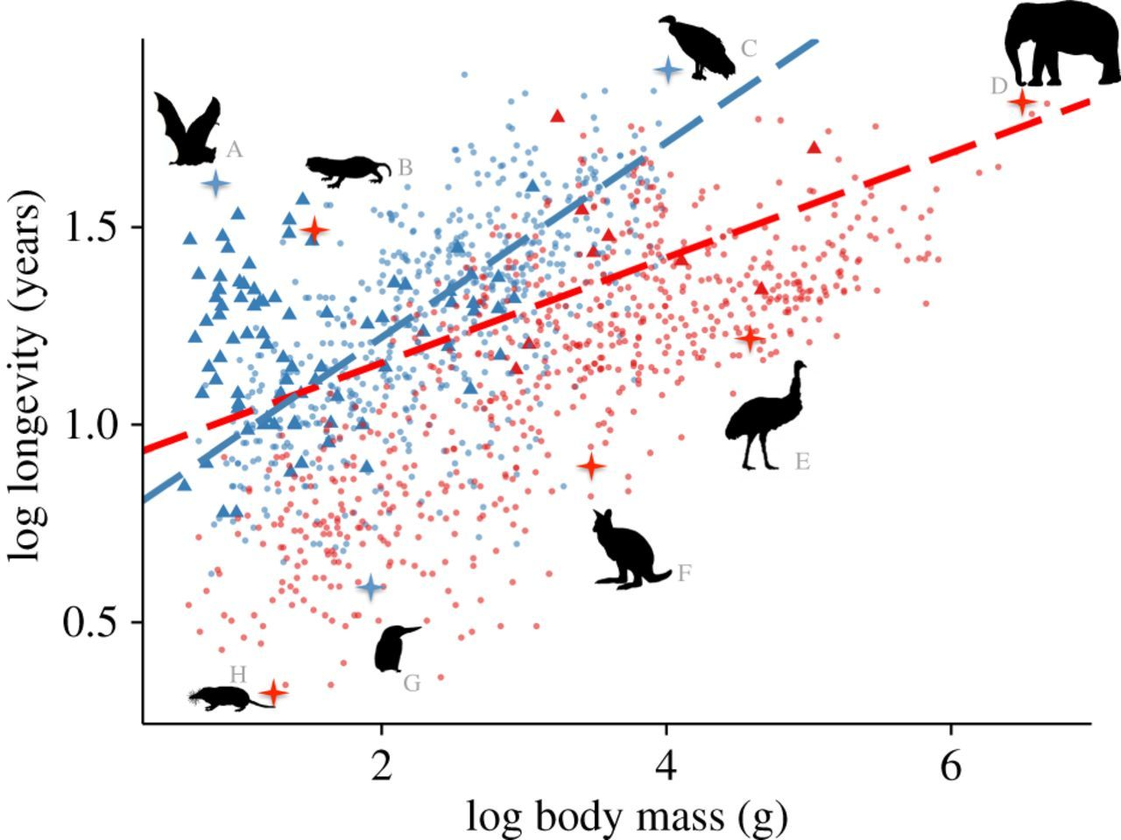
Stats lecture 7 ANCOVA

Slide 2
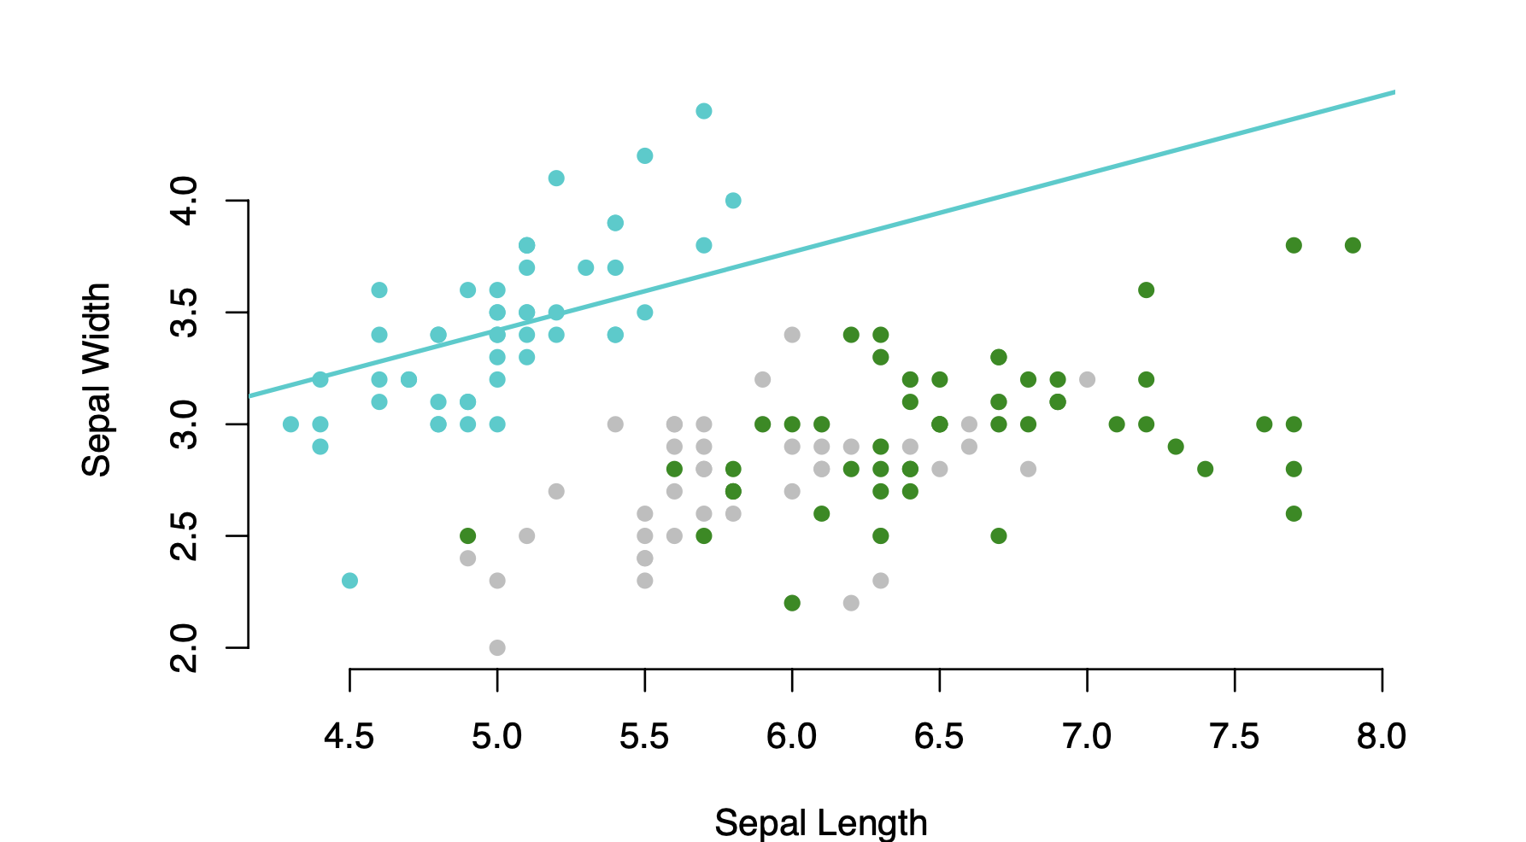
ANCOVA (Analysis of Covariance)
ANCOVA
Analysis of covariance is a general linear model which blends ANOVA and regression.
Last week we looked at how to fit a line to a single set of data.
But what if there are multiple groups?
We might want to fit a separate line for each group
What if we have multiple groups as shown by the different colors?
response
explanatory

Slide 3
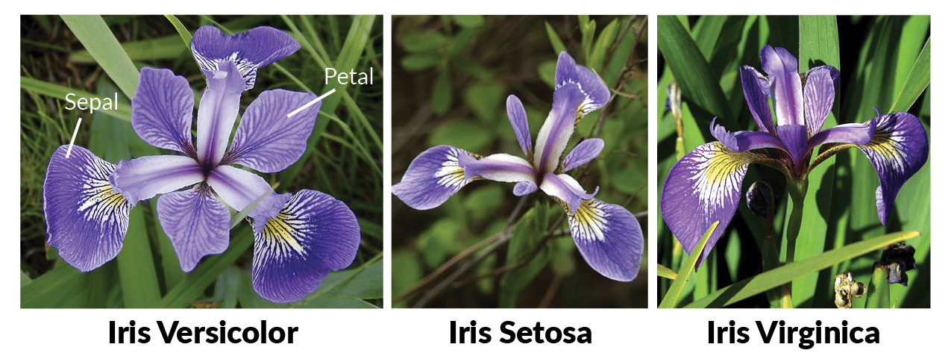
Lets test if sepal width increases with sepal length using the iris dataset iris_data <- iris

Slide 4
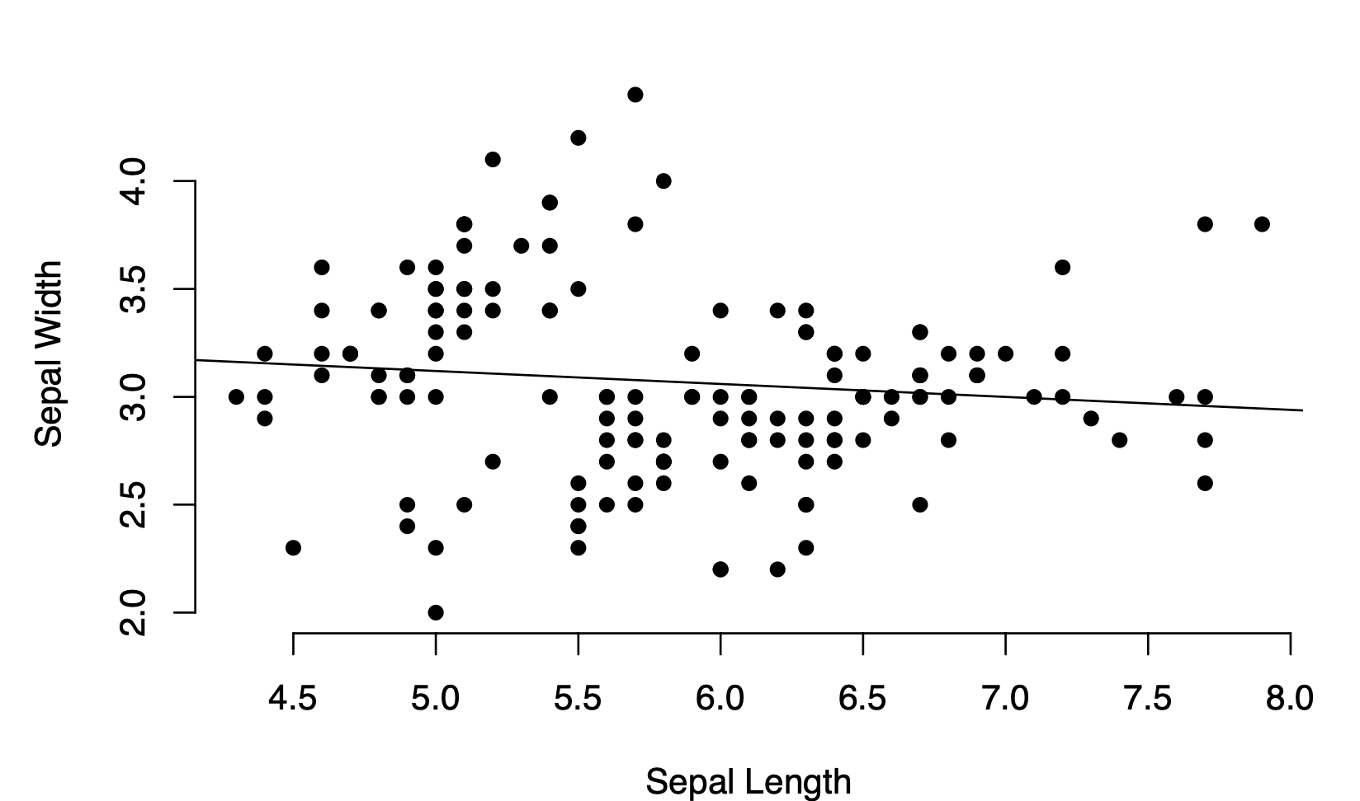
Relationship between sepal length and width
We think sepal width changes in response to change in length so width goes on the y-axis as the response variable.
We think sepal length is the driver so it goes on the x-axis
as the explanatory variable

Slide 5
Linear Models
Lines can be expressed as
y = Mx + c
Response variable
The y-axis values
for the data
The Slope of the
Line. A coefficient with 1 value
Explanatory variable
The x-axis values
for the data
The intercept of the
Line. A coefficient with 1 value

Slide 6
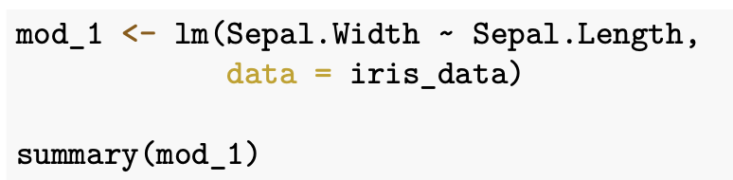
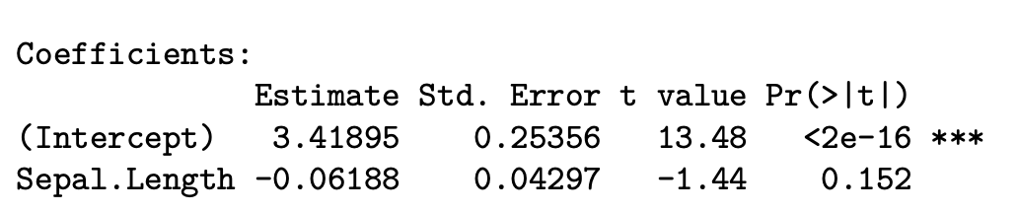
Relationship between sepal length and width
y = Mx + c

Slide 7
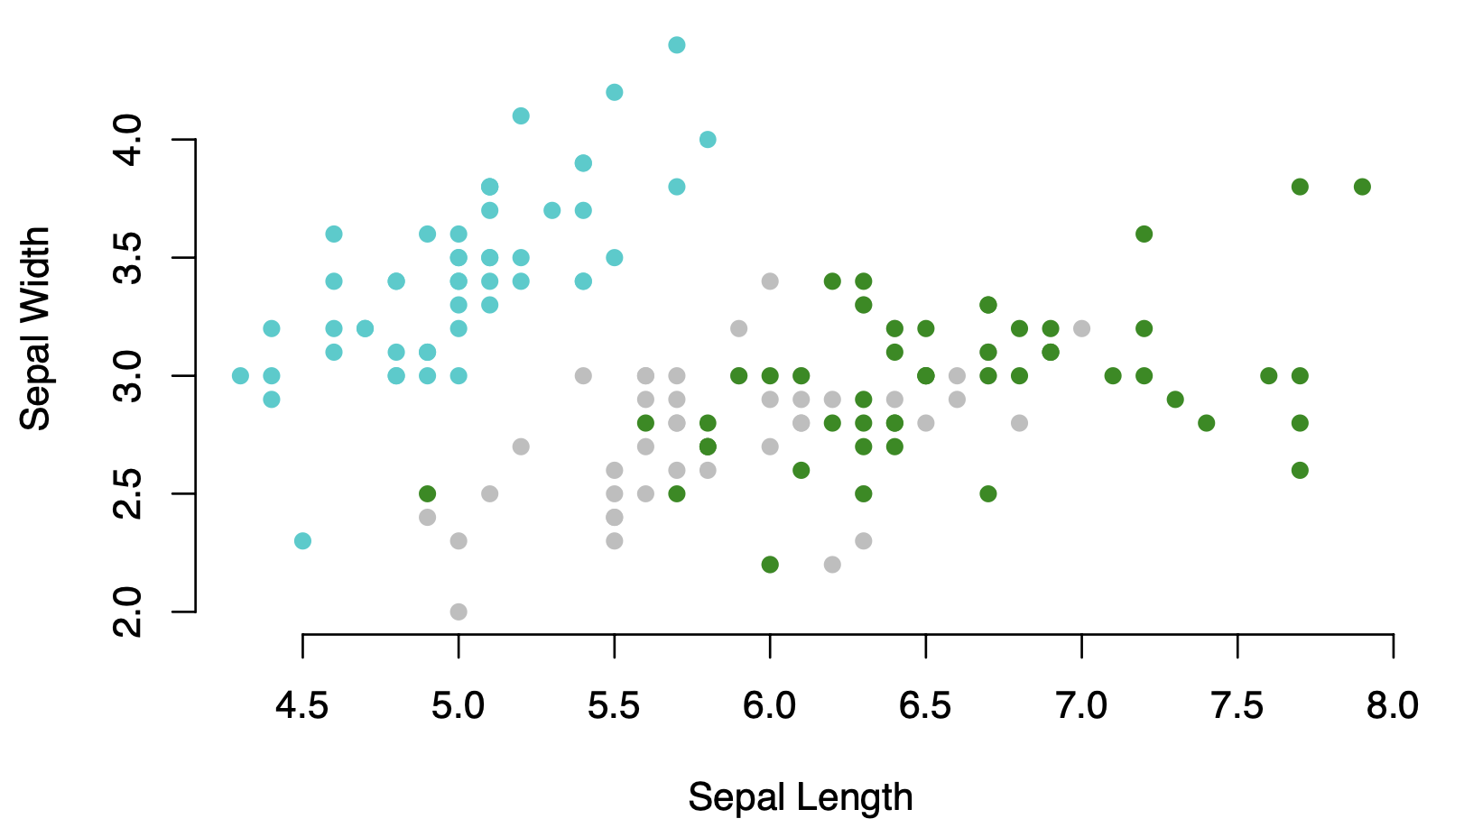
However, if we plot each species as a different colour it’s clear that the relationship between length and width might be different for each species
?
?
?

Slide 8
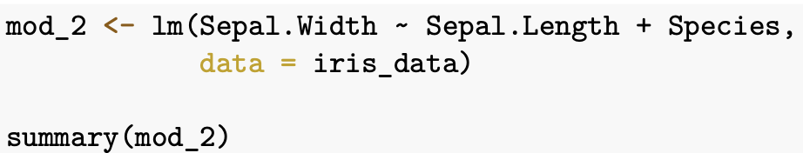
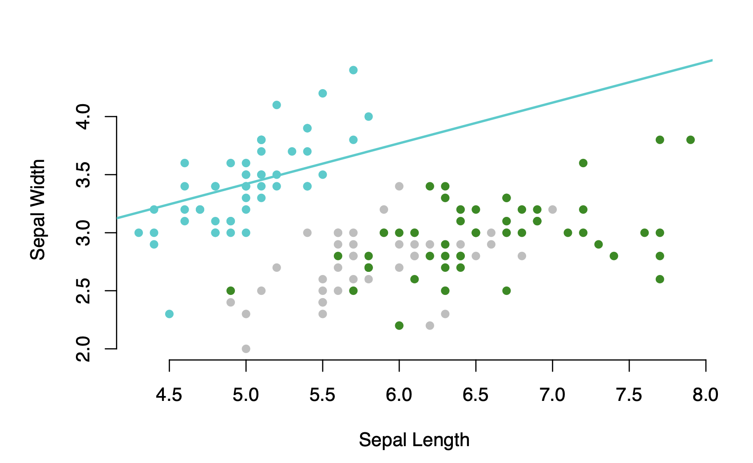
ANCOVA- Fits a baseline
and uses contrasts to test if they are different.
To add in a new line for each group we include the categorical factor as an explanatory variable

Slide 9
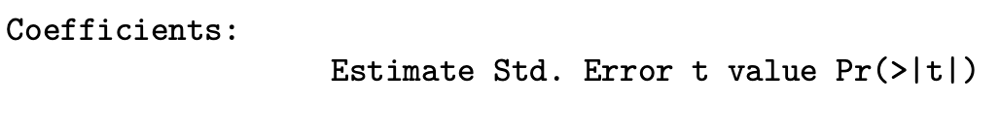
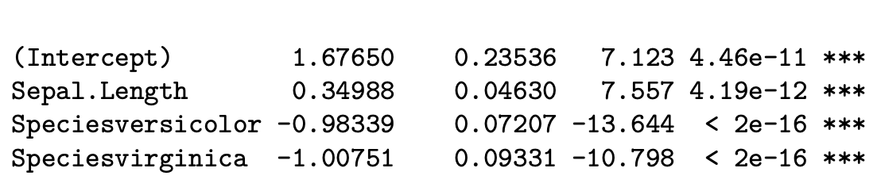
ANCOVA- Fits a baseline
and uses contrasts to test if they are different.
First two rows still give the estimates for
the intercept (1.68) and the slope (0.35).
This is the baseline and is the first group in alphabetical order of the groups in the variable Species
Here its setosa

Slide 10
ANCOVA- Fits a baseline
and uses contrasts to test if they are different.
We can also see that both the intercept and slope are significantly different to the NULL model which is the value zero

Slide 11
ANCOVA- Fits a baseline
and uses contrasts to test if they are different.
The line Speciesversicolor is for the versicolor line

Slide 12
ANCOVA- Fits a baseline
and uses contrasts to test if they are different.
The line Speciesversicolor is for the versicolor line
This estimate gives us the difference between the intercept for the baseline and the intercept for the line for versicolor

Slide 13
ANCOVA- Fits a baseline
and uses contrasts to test if they are different.
Hence the actual intercept for the versicolor line is
Baseline intercept (1.68) – difference (0.98) = 0.7

Slide 14
ANCOVA- Fits a baseline
and uses contrasts to test if they are different.
The p-value here refers to whether the versicolor line is significantly different to the baseline
The NULL is that the baseline and the versicolor line do not have different intercepts.
This type of comparison is called contrasts

Slide 15
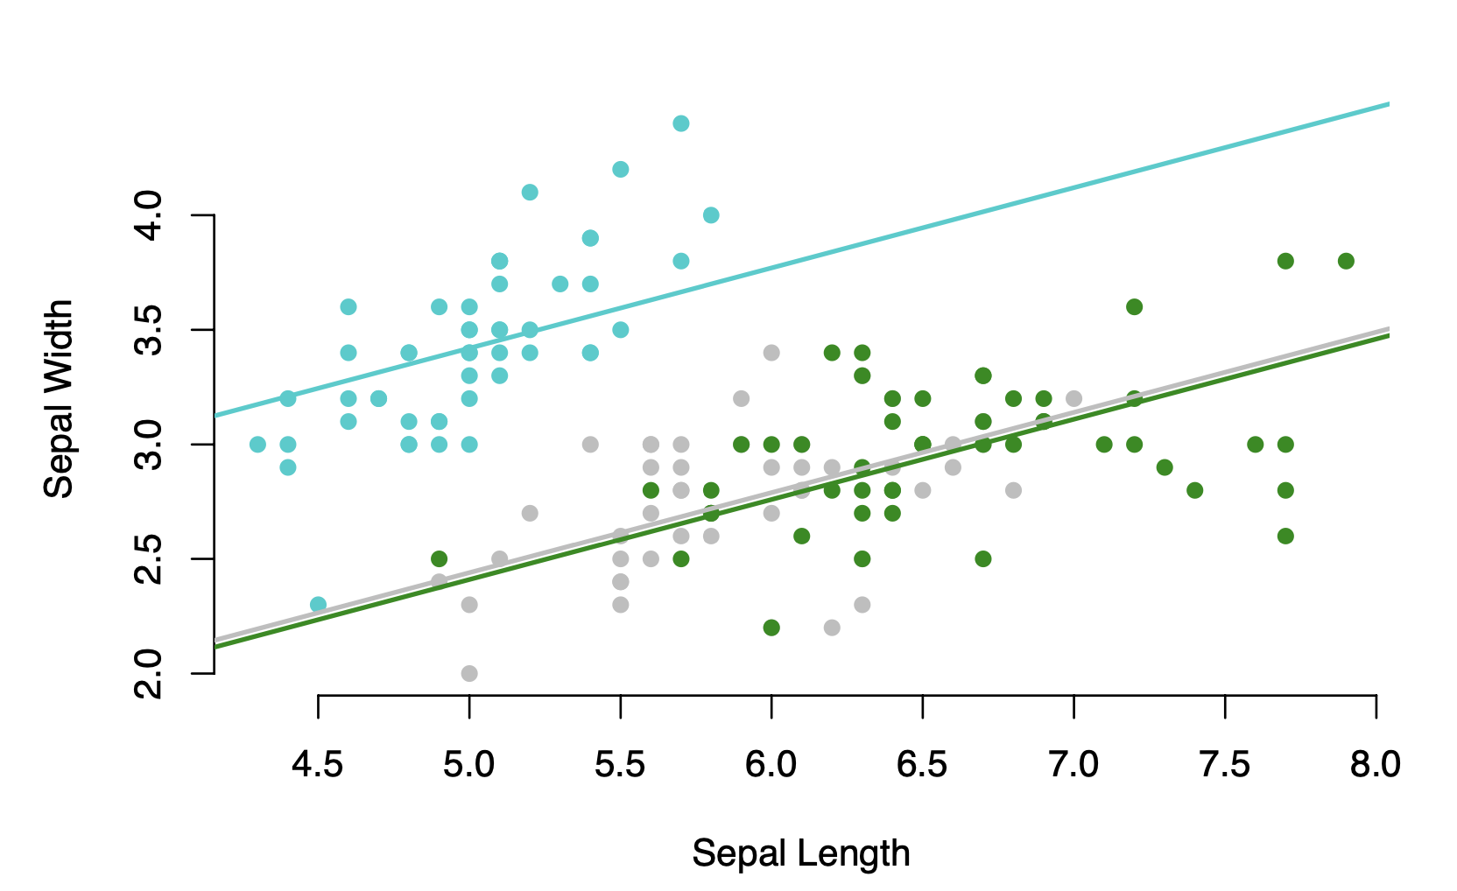
ANCOVA- Fits a baseline
and uses contrasts to test if they are different.
The line Speciesvirginica is for the virginica line
This estimate gives us the difference between the intercept for the baseline and the intercept for the line for virginica

Slide 16
ANCOVA- Fits a baseline
and uses contrasts to test if they are different.
The line Speciesvirginica is for the virginica line
This estimate gives us the difference between the intercept for the baseline and the intercept for the line for virginica

Slide 17
ANCOVA- Fits a baseline
and uses contrasts to test if they are different.
The p-value here refers to whether the virginica line is significantly different to the baseline
The NULL is that the baseline and the virginica line do not have different intercepts.

Slide 18
ANCOVA- Fits a baseline
and uses contrasts to test if they are different.
This mode tells us that as sepal length gets longer I can expect sepal width to increase according to the slope which was 0.35
It also tells me that Setosa has wider sepal compared to the other two species by about 1 cm

Slide 19
However we assumed every species had the same slope
We assume no interactions between the species and sepal length
Interactions
An interaction is when 1 explanatory variable effects how the other explanatory variable relates to the response variable.
Here we

Slide 20
Interactions are when two or more
explanatory variables have combined effects
Extra growth from the interaction between having both added nutrients and heat
Extra growth from added nutrients
Plant growth
(cm/day)
Extra growth from heat
Plant growth under control
control
Control
+ nutrients
Control
+ heat
Control
+ nutrients
+ heat

Slide 21
ANCOVA- Fits a baseline
and uses contrasts to test if they are different.

Slide 22
ANCOVA- Fits a baseline
and uses contrasts to test if they are different.
We can add an interaction term between Sepal.Length and Species using the : symbol

Slide 23
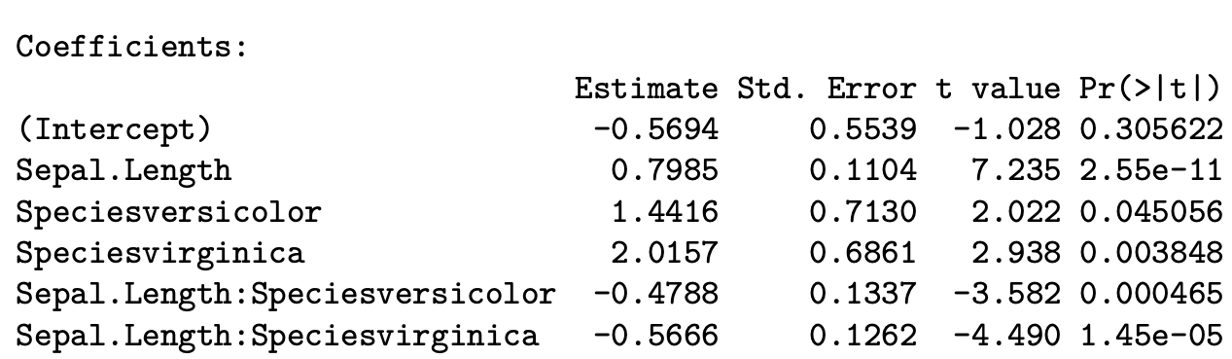
ANCOVA- Fits a baseline
and uses contrasts to test if they are different.
The first 2 lines still give you the intercept and the slope of the baseline

Slide 24
ANCOVA- Fits a baseline
and uses contrasts to test if they are different.
The Speciesversicolor line still gives the difference between for the intercept for the versicolor line and the intercept for the baseline. This difference is also significant as p < 0.05
The intercept for the versicolor line is
-0.57 + 1.44 = 0.87

Slide 25
ANCOVA- Fits a baseline
and uses contrasts to test if they are different.
The Sepal.Length:Speciesversicolor line gives the interaction effect for length and the group versicolor
This value is the difference in the slope between the baseline and the fitted versicolor line. This difference in slopes is also significant as p < 0.05
The slope for the versicolor line is hence
0.80 – 0.49 = 0.31

Slide 26
ANCOVA- Fits a baseline
and uses contrasts to test if they are different.
Since we know know the intercept (0.87 )
and slope (0.31) for the
Versicolor line we can plot it

Slide 27
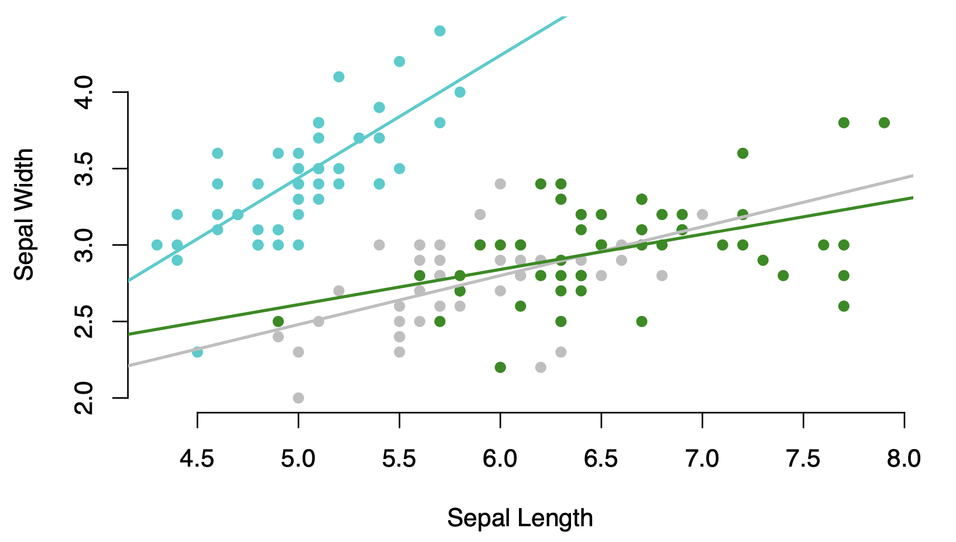
Model selection
Which model would you choose to report and why?
Mod_1: Model with no groups or interactions
Mod_2: Model with no interactions
Mod_3: Model with interactions

Slide 28
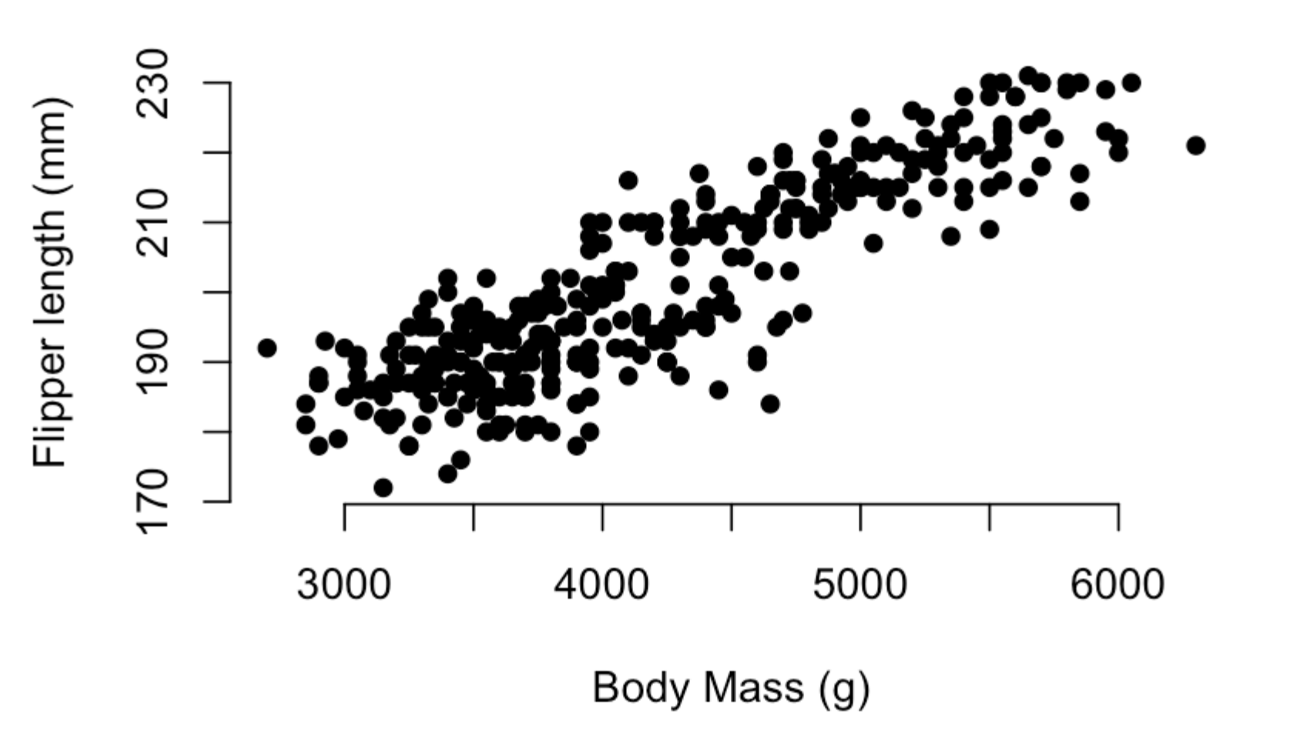
Linear Models
Residuals and model fit
A
We calculate the residuals of every point to the fitted line.
And get the sum of the squares of these residuals.

Slide 29
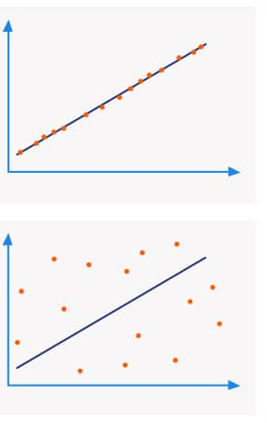
R-squared
We can also ask how close the data is to these correlations with what is called the R-squared value.
High R-squared values indicate that most of the variance in the response variable is explained by the explanatory variable.
R-squared is between 0 and 1 and is simply calculated as the square of the coefficient of correlation
R-squared close to 1
R-squared closer to zero

Slide 30


Model selection
Which model would you choose to report and why?
Mod_1: Model with no groups or interactions
Mod_2: Model with no interactions
Mod_3: Model with interactions

Slide 31
Model selection
I could build a model with as many lines as I wanted (imagine as well as species I had a line for every sub population and every different location etc etc )
By adding more lines I will always get a better fit as the data points will be closer to the lines

Slide 32
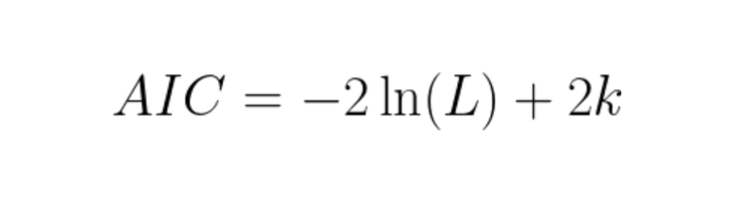
Model selection
Akaike Information Criterion (AIC)
A measure that accounts for how well a model fits the data and how many parameters it uses.
This part measures how well the model fits the data
(called the log likelihood its very close to the sum of squares measure)
k stands for the number of parameters
Every intercept, slope, interaction terms etc counts as a parameter

Slide 33
Model selection
Akaike Information Criterion (AIC)
A measure that accounts for how well a model fits the data and how many parameters it uses.
The model with the lowest AIC value is deemed the best model
It balances fit while penalizing complex models
*If models are within 2 AIC values of each other we usually pick the simpler model

Slide 34
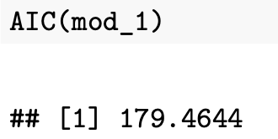
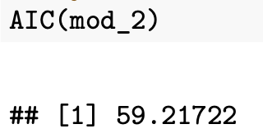
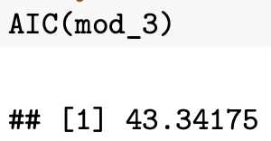
Model selection
Which model would you choose to report and why?
Mod_1: Model with no groups or interactions
Mod_2: Model with no interactions
Mod_3: Model with interactions
Lowest AIC so we would pick this model

Slide 35
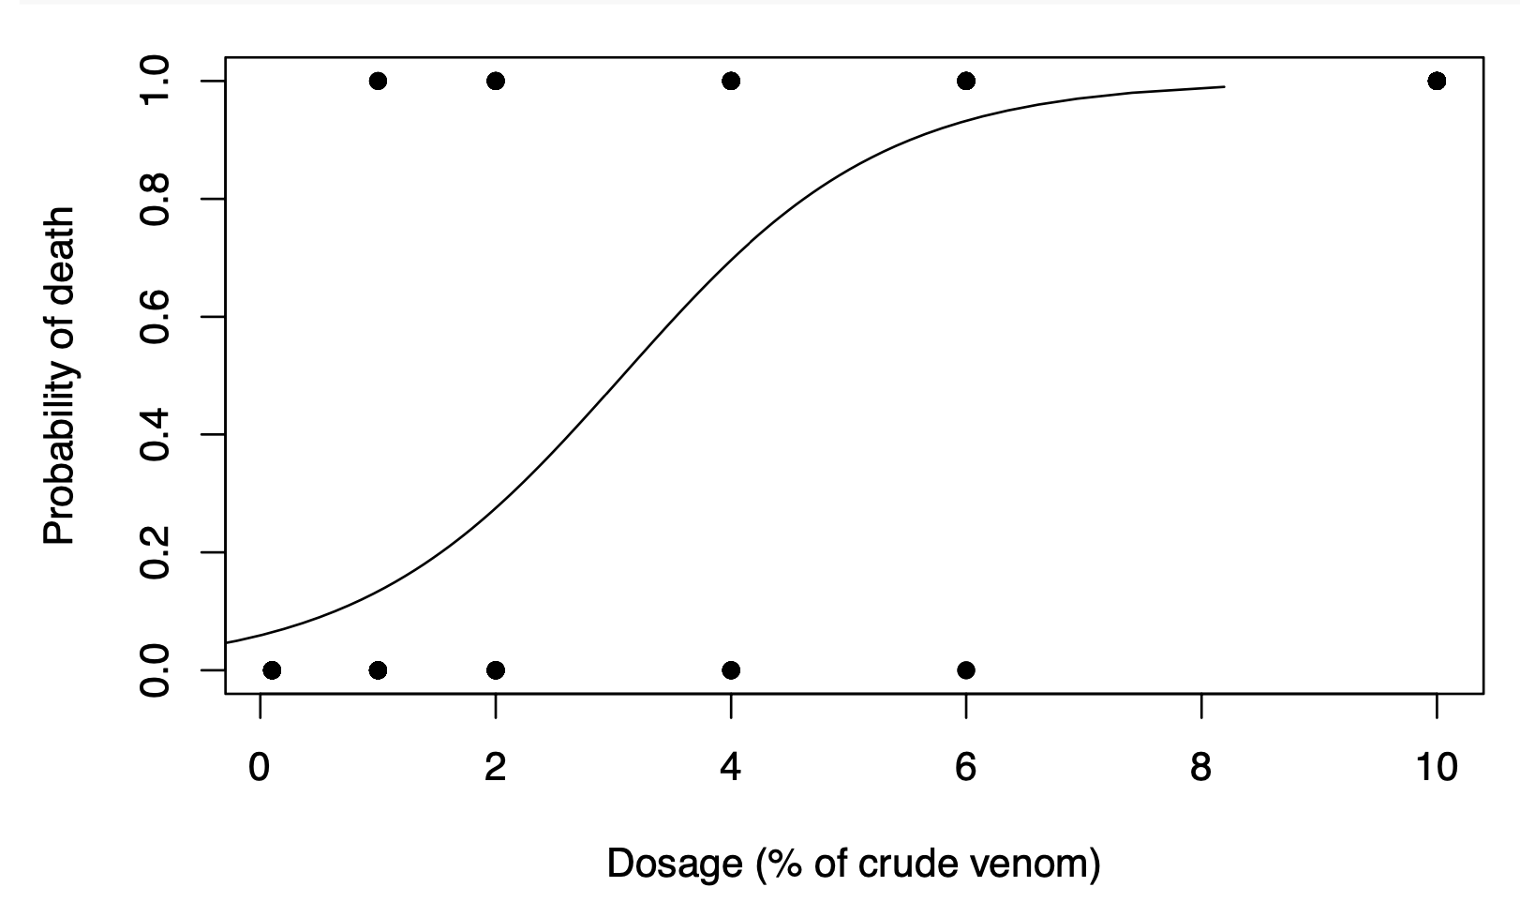
Generalized linear models (GLM)
Expands linear models for different type of data
Example Binary data
Imagine we run a series of traits testing how potent a spider venom was.
At the start we inject a number of crickets with different concentration of the venom and then wait 24 hours to see if they are still alive or dead.
This is binary data as the response variable data is either 0 (alive) or 1 (dead).
Dead
Alive

Slide 36
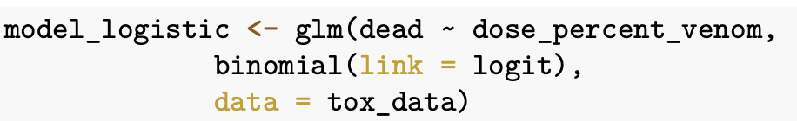
Generalized linear models (GLM)
Expands linear models for different type of data
Example Binary data
We can use a glm and tell it the data is binary, using what is called the link
Dead
This fits a model that is S-shaped that now describes the probability of death for different dosages.
This is just as an example of what glms can do but we won’t cover them in any more detail here.
Alive

